Slide 1
Kilkenny County Council
Vacant Homes
Presentation to Members
November 2019

Slide 2
Vacant Homes Action Plan- Survey Overview
April 2018-September 2019 county-wide visual survey carried out in areas of greatest housing demand
Owners identified where possible and efforts made to engage regarding reactivation of property for social housing using a variety of schemes.
244 Potential Vacant Homes identified including those listed on www.vacanthomes.ie
40 listed in KK to date-31 now deleted various reasons
Notes:
Ongoing review of properties
Must be deemed recoverable
Ongoing engagement with owners
Vacant Homes website revamped in September- many properties listed are now deleted as no longer vacant / subject of other schemes/in financial difficulties or unsuitable

Slide 3
Vacant Homes Action Plan- Survey findings
25% now refurbished/occupied/privately rented, sold or for sale
Note-Interaction with Housing Agency useful
12% confirmed unavailable/not vacant
15 units identified for multi-unit development sites for mix of LA capital projects, turn-key, AHB or leasing schemes
14 units within Upper Bridge Street Callan Pilot Residential Regeneration Project
Notes:
Since survey started 25% no longer vacant
Good interaction with the Housing Agency. They have strong relationship with Financial Institutions & Equity Funds
Percentage not available-people want to hold on for family members or someone actually living there or maybe part-time
8 units acquired by AHBS & 7 more identified for multi-use developments

Slide 4
Vacant Homes Action Plan- Survey findings contd.
15% still vacant for various reasons:
Title/registration/legal issues/difficulty identifying owners
Older properties/poor condition/high cost solutions
Financial problems
Multiple family members/inheritance issues
Social problems/illness
Owner in nursing home
8% Derelict or unrecoverable or in areas of no demand
Development in abeyance for small number of units pending larger development aggregation
Notes:
Complex reasons for vacancy

Slide 5
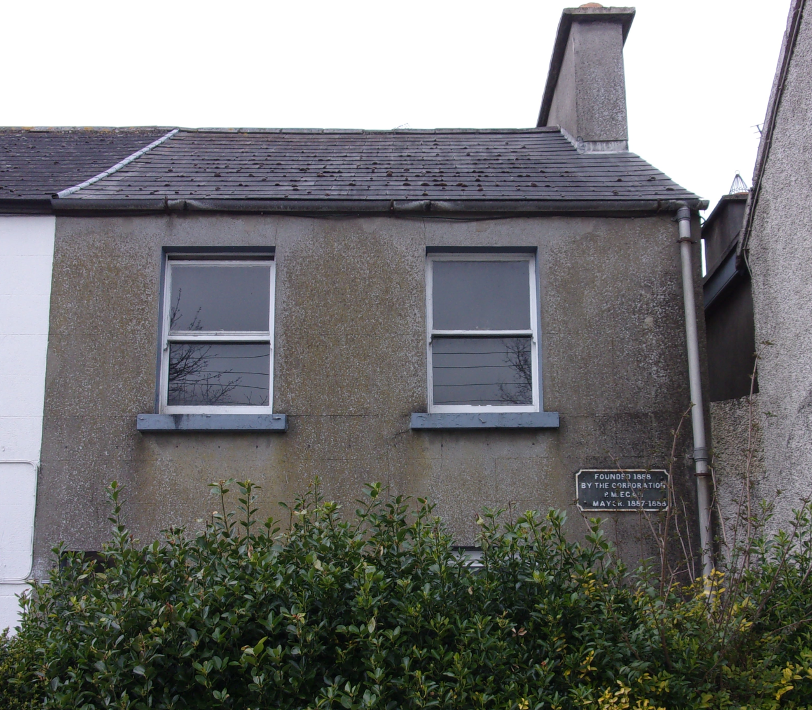
Vacant Homes Action Plan
Notes:
1 Laurel Court, Loughboy- Vulture Funds involved.
Pursued via Housing Agency & forced action on sale of property last April.
16 Barrack St.- refurbished provately
26 Parnell St.- Following death of original owner niece now taken possession

Slide 6
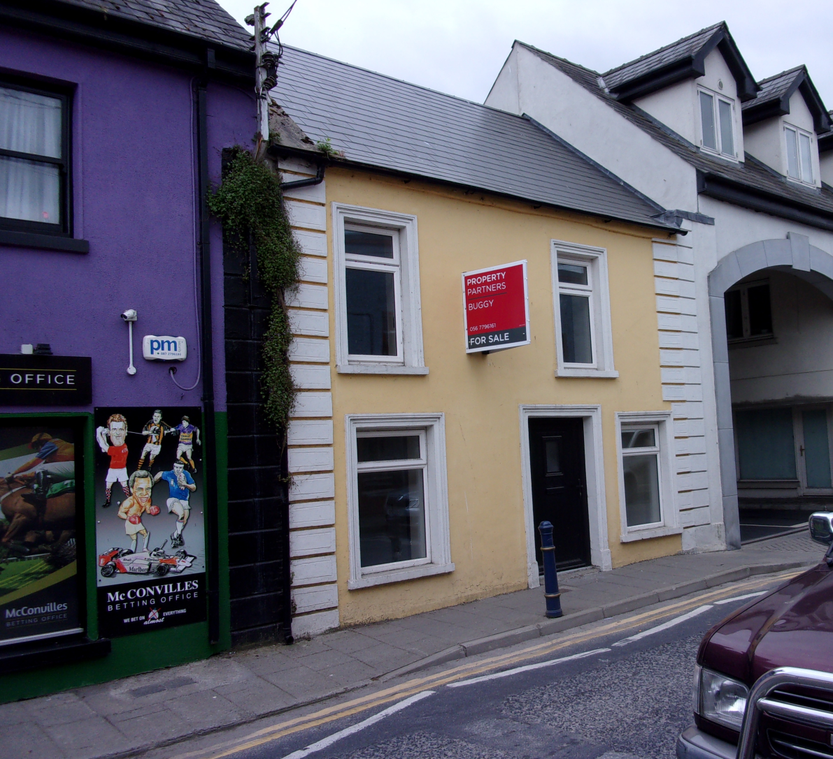
Vacant Homes Action Plan
Notes:
61 Maudlin Street.
We pursued solicitors regarding estate of deceased owner & now for sale
Logan Street- owner interested in leasing/rental with KCC

Slide 7
Vacant Homes Action Plan-Repair & Lease Scheme
Poor take-up of scheme in Kilkenny and nationally.
34 engaged for potential Repair & Lease Scheme-1 unit completed/occupied to date+ another about to sign up in city
Majority applications for older/poor quality houses which may be unsuitable or beyond scope of R& L scheme.
Applicants put off by level of work, lack of technical knowledge/expertise & standards required.
Scheme under review by Department of Housing-acknowledgement that €40k limit loan set too low.

Slide 8
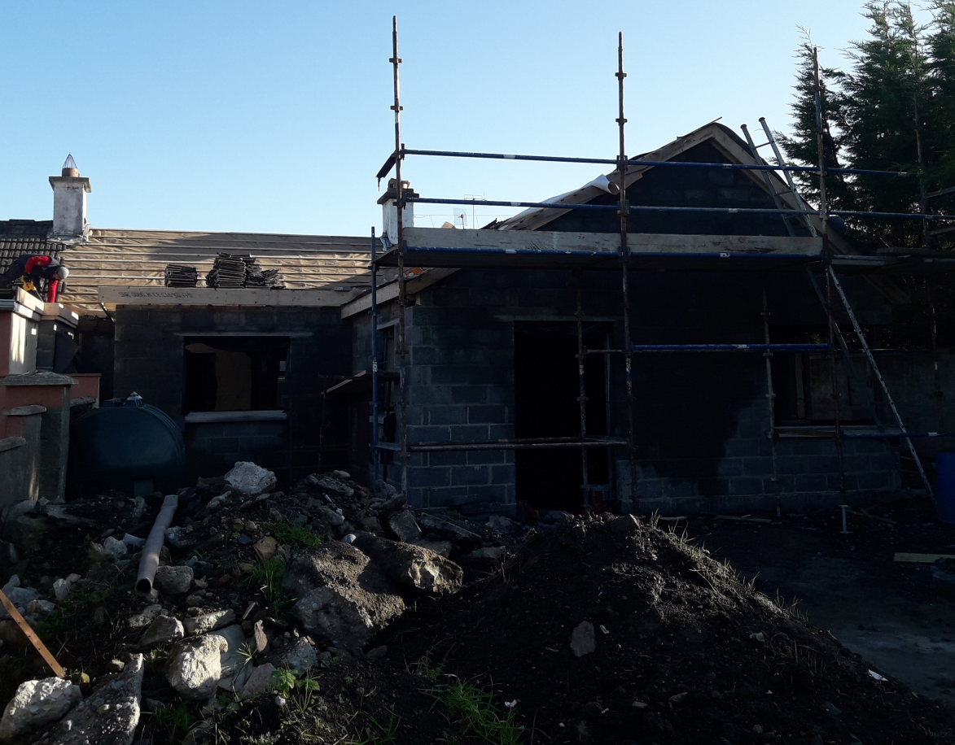
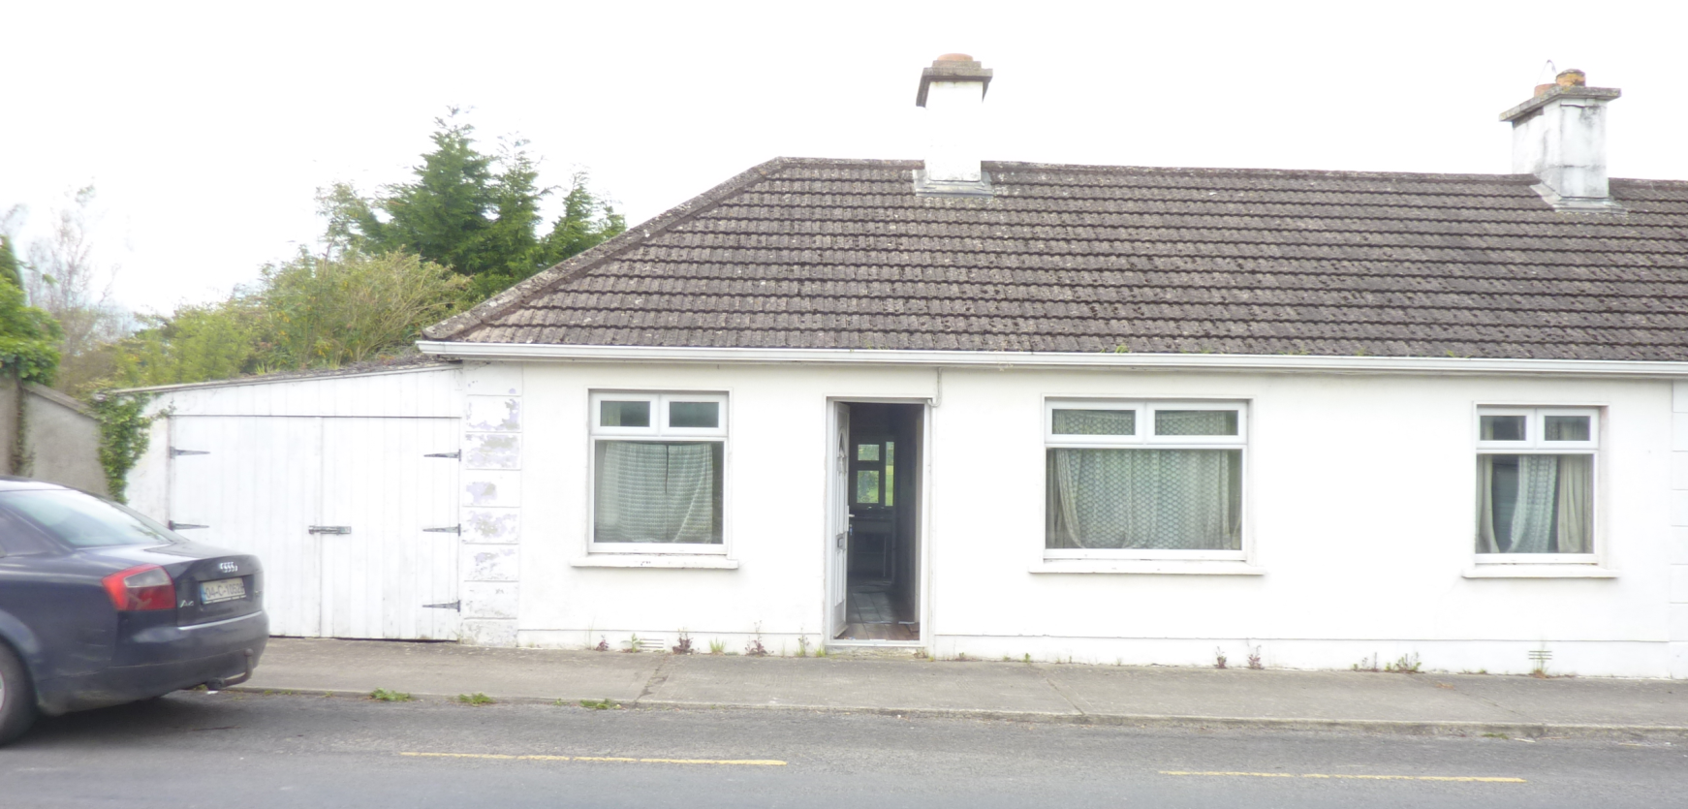
Vacant Homes Action Plan-Buy & Renew Scheme
Better potential for limited number of units.
Good opportunities for small urban renewal interventions.
Progress slow to complete purchases on older properties due to title or family issues.
21 engaged for potential Buy & Renew Scheme-1 unit completed/occupied to date & 2 No. currently on site
Notes:
Man St. Kilmoganny
Vacant 12 years- major refurb/extension for wheelchair user & her family. ON SITE

Slide 9
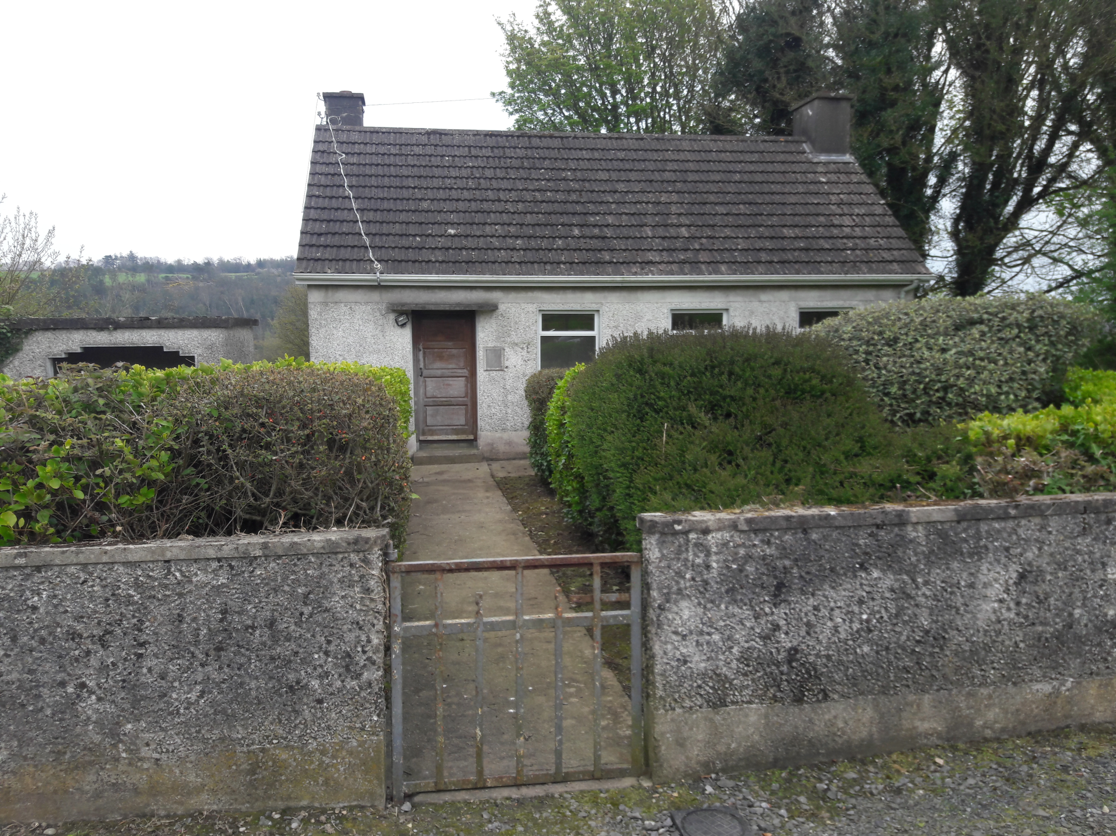
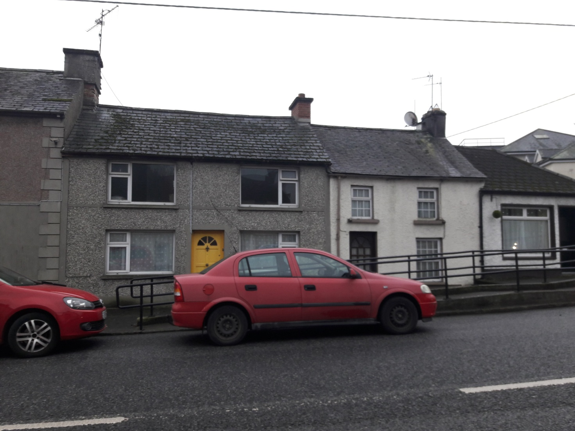
Vacant Homes Action Plan- Buy & Renew
Notes:
HSE Legacy properties
Windgap Health Centre- On site for 1 bedroom bungalow. Similar units in Kells, Kilmacow & Stoneyford
Barrack Street Castlecomer- refurb just gone to tender

Slide 10
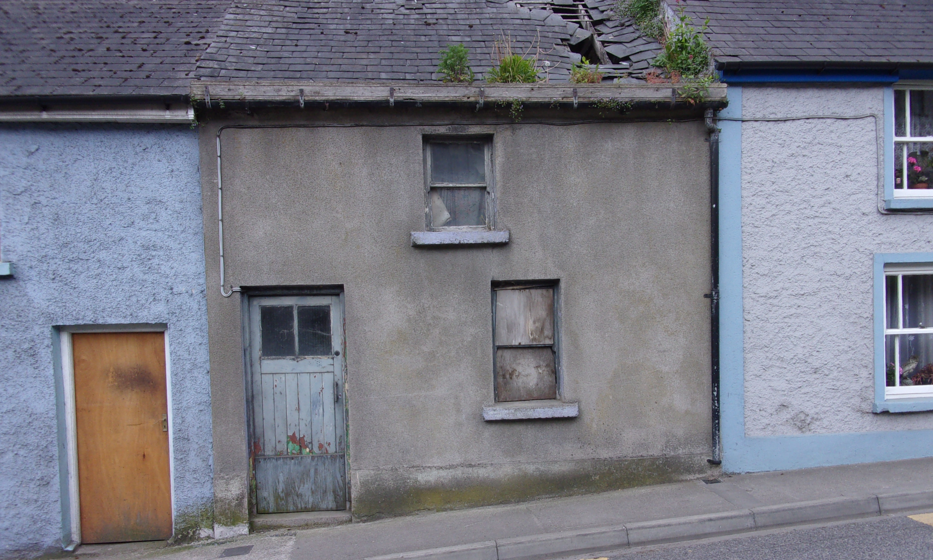
Vacant Homes Action Plan-CPO
Potential for certain buildings highlighted as long-term or problematic sites.
Time-consuming process to complete. Good opportunities for small urban renewal interventions.
Notes:
2 Houses Canal Road, Johnstown now acquired under CPO
Considering demolition under Dangerous Structures &
2 house infill scheme being prepared for Dept.
7 Maudlin St., Thomastown
House listed on RPS- urban regeneration of the street with various properties

Slide 11
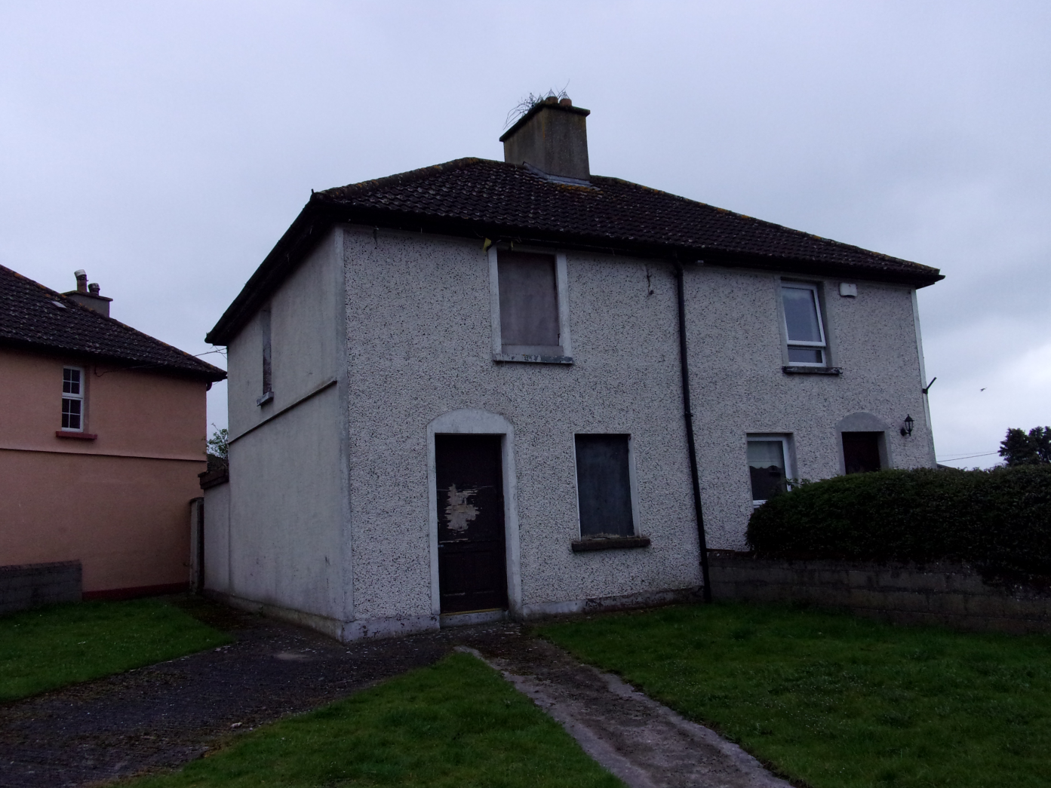
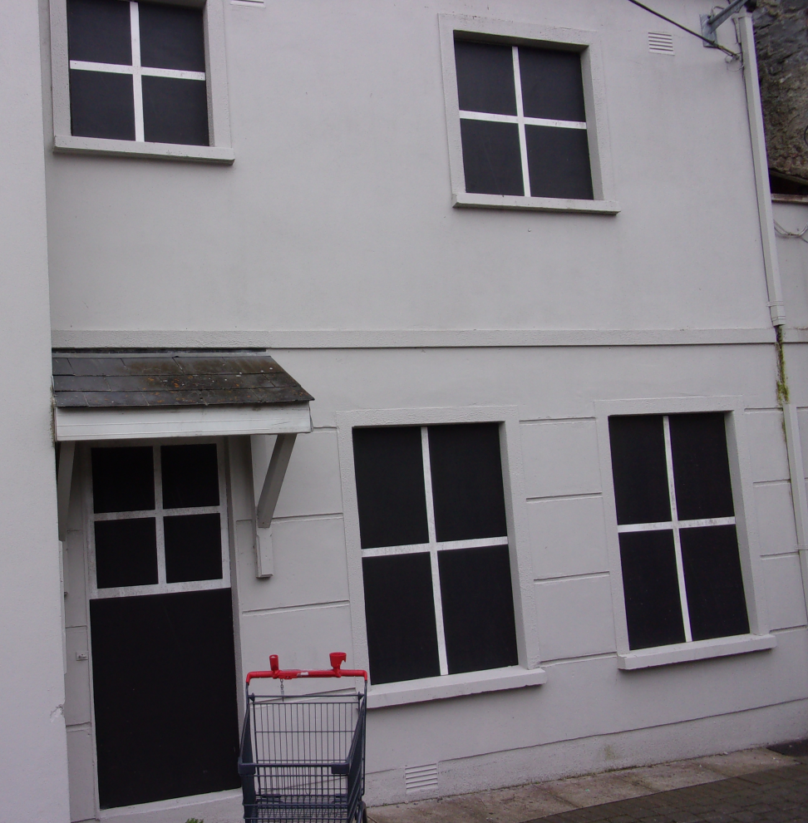
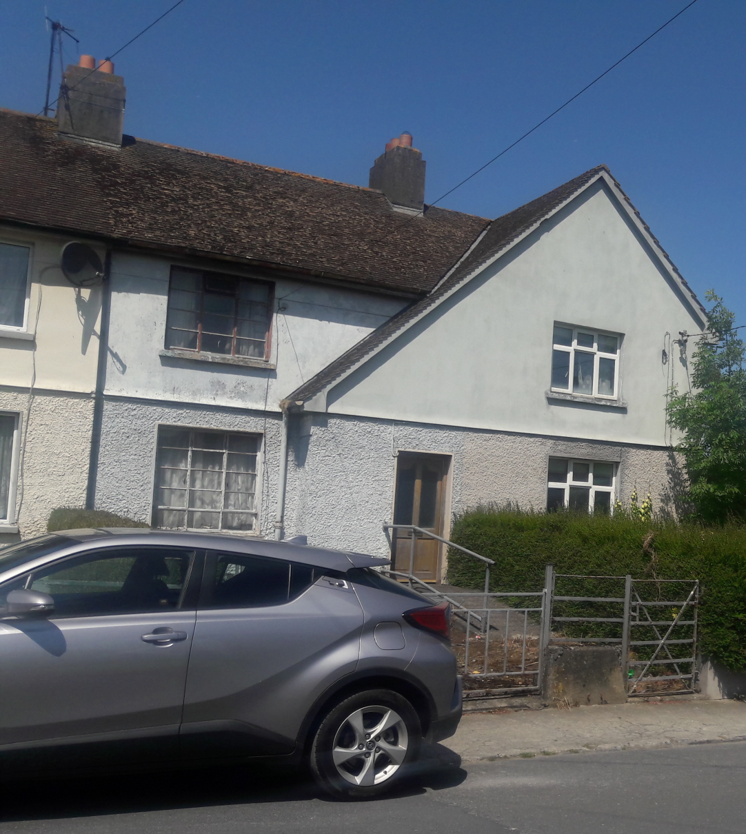
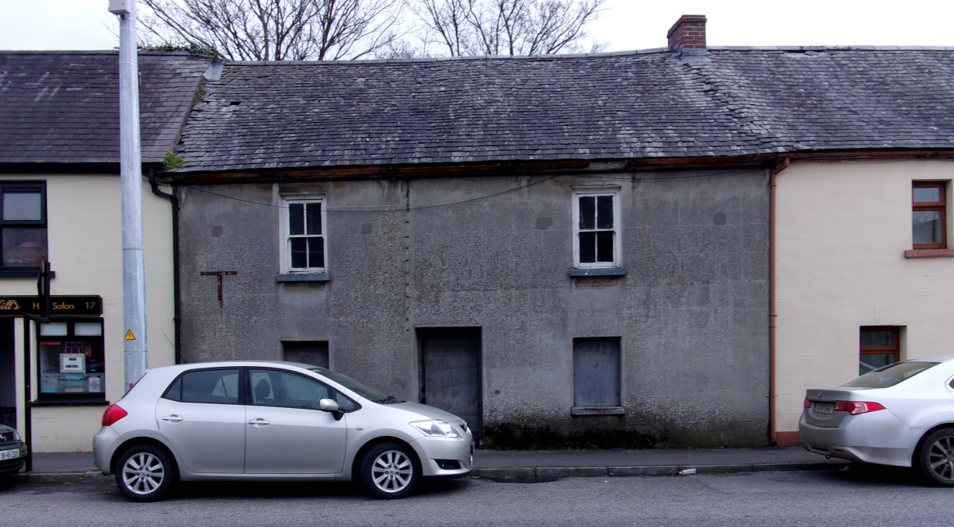
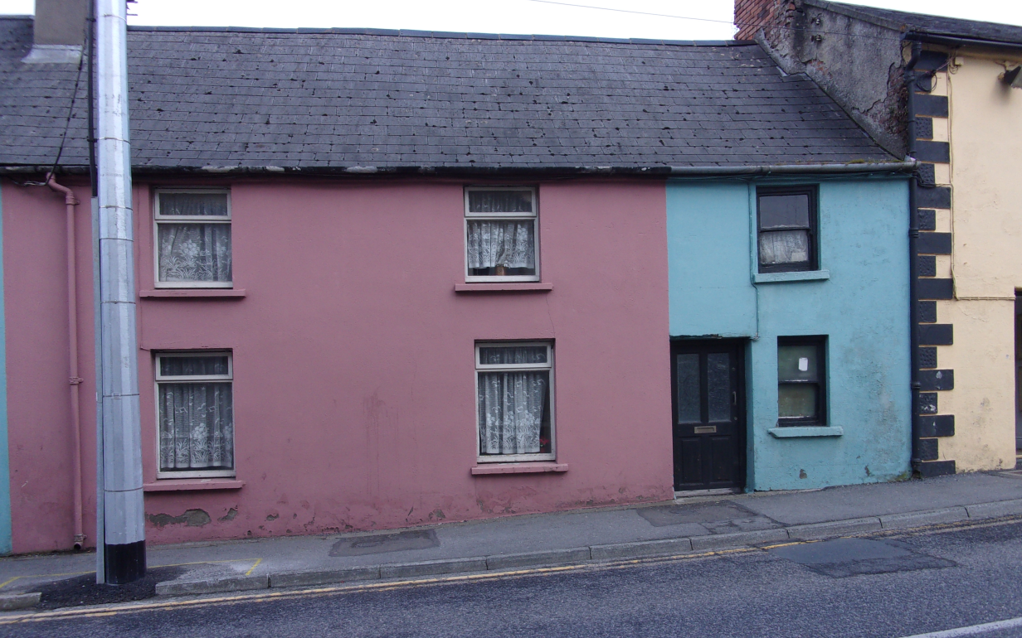
Vacant Homes Action Plan-CPO
Notes:
10 Blackmill St., Kilkenny
34 Pearse St., Kilkenny
11 Tilbury Place
17 Upper Patrick St., Kilkenny
8 Upper Patrick St., Kilkenny (next to 6/7 HSE properties- AGGREGATION)
25 & 26 Collins Park, Callan

Slide 12
Vacant Homes Action Plan-Turnkey & Leasing
CONCLUSION
244 properties surveyed to date
Concentration of effort in the city & high demand areas
Move spotlight to other towns in 2020
Local knowledge vital for specific properties or sites to be brought to our attention
Notes:
Call for Expressions of Interest
MGM Construction Expression of Interest submitted for 70/71 Upper Patrick St. for development 4 apartments for turnkey/long term lease
CONCLUSION
Help from elected members would be appreciated wrt specific sites

Slide 13
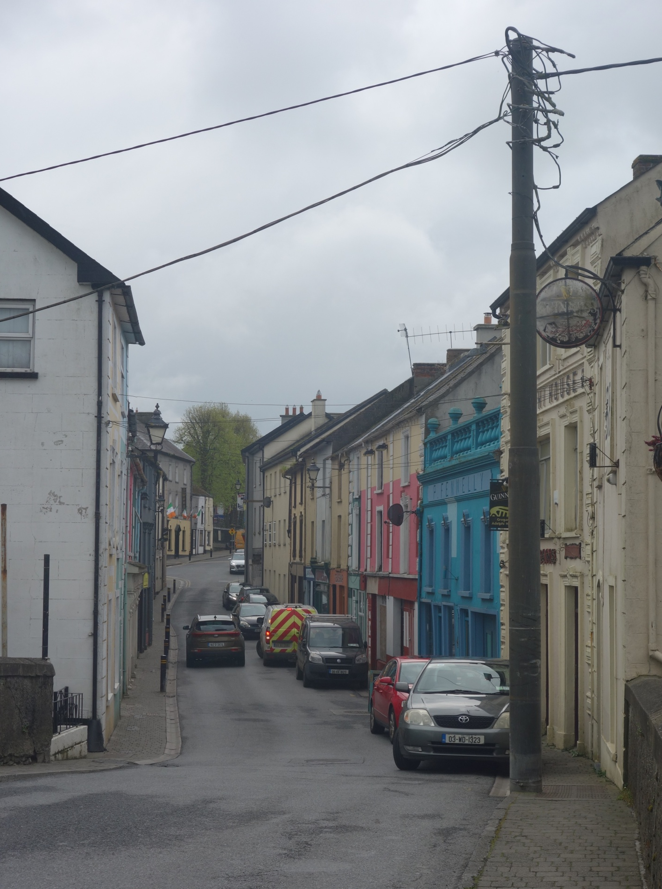
Vacant Homes Action Plan- Callan Pilot Regeneration Project
1 of 4 district towns 16 km SW of Kilkenny City
Callan population of 2,475 in 2016 +6% on 2011
Historic 13th C core on King’s River- Upper Bridge St. at the heart
Callan Health Check 2018
Callan has 16% vacancy (28 out of 179)
Vacant housing 10%
Bridge St. accounts for 42% of vacant properties in Callan
Anglo-Norman motte and the Augustian Abbey
Thriving Arts community

Slide 14
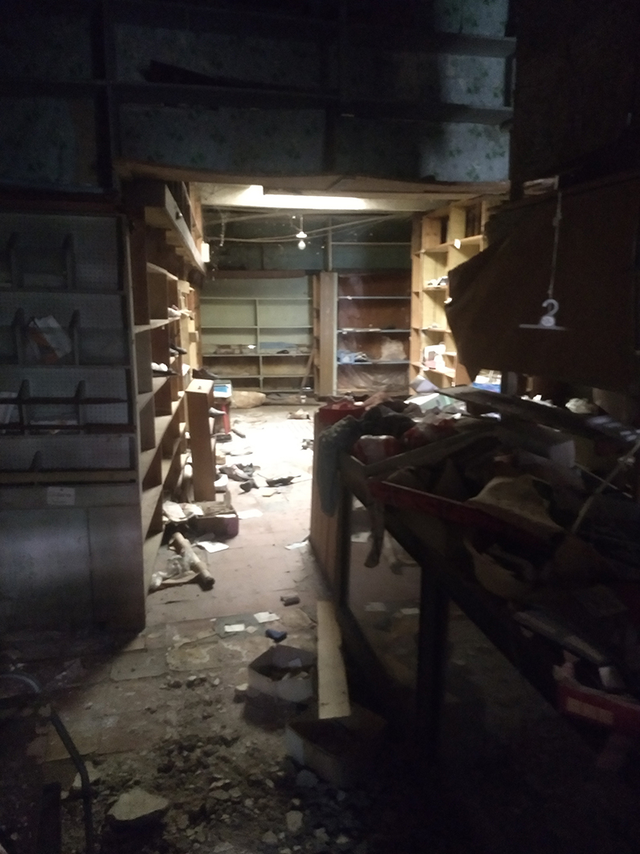
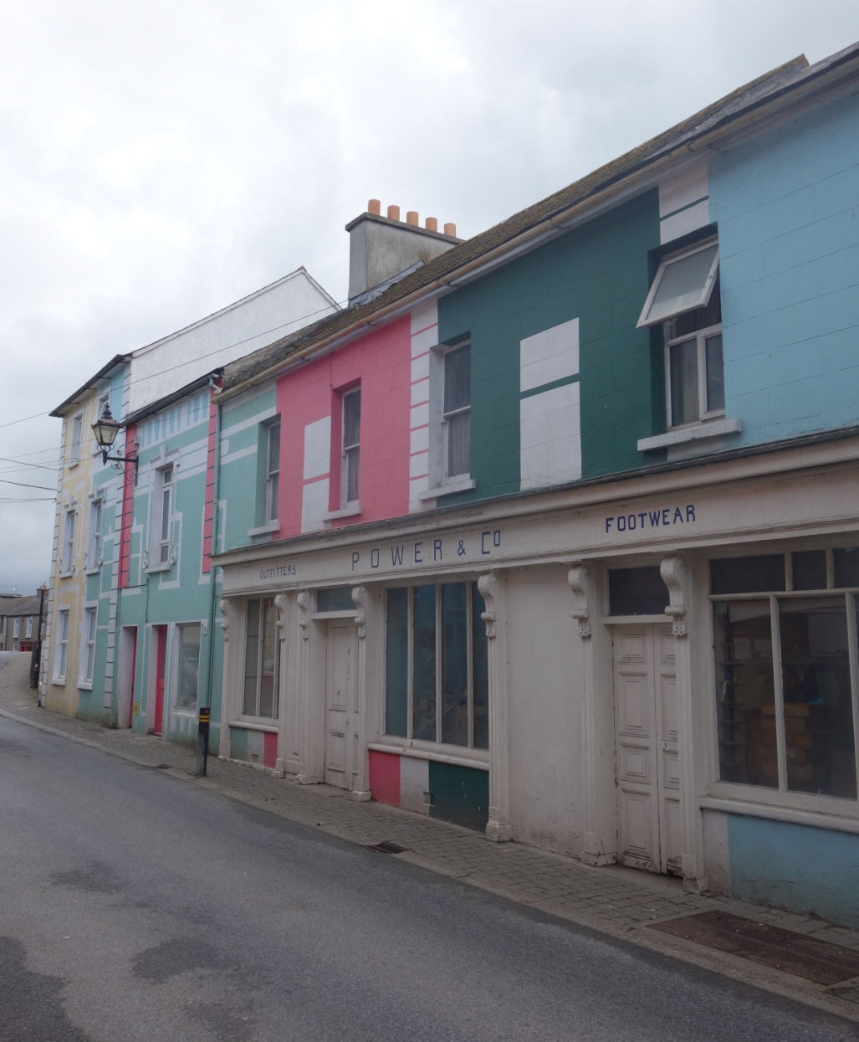
Vacant Homes Action Plan- Callan Pilot Regeneration Project
PROJECT APPROACH
Identify opportunities to develop vacant/under-occupied premises for residential use in tandem with retaining retail opportunities in selected locations
Develop proposals for potential repair interventions to high conservation standards using high quality long lasting materials
Develop low carbon, energy efficiency strategy including suitable and compatible materials for the buildings
Improve image of the street and exploit its built and visual assets
To identify grants and financial incentives
Focus on 3 typologies- 5 buildings

Slide 15
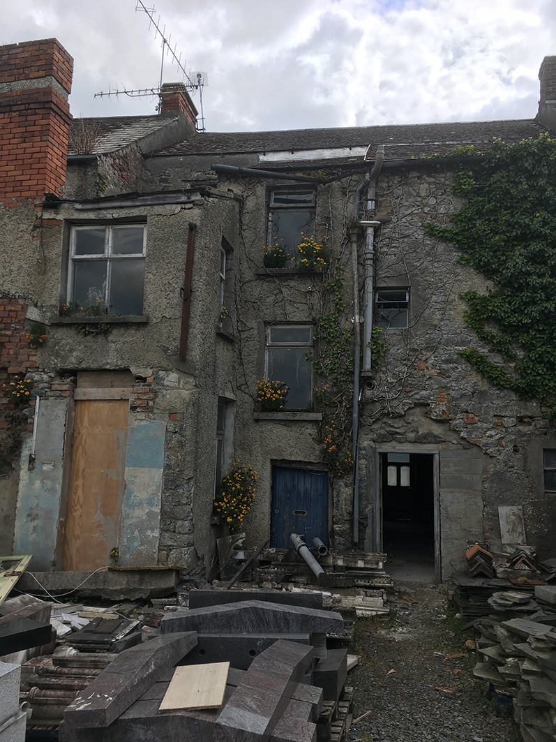
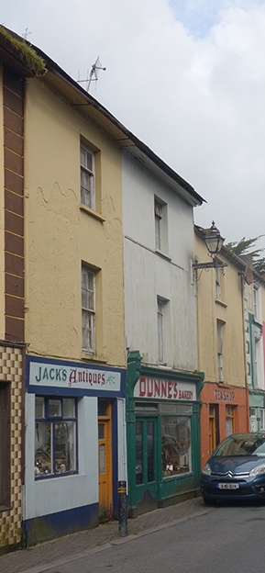
Vacant Homes Action Plan- Callan Pilot Regeneration Project
WHAT IS THE PROBLEM HERE?
Traffic congestion
Parking
Age & condition of the buildings
Older residents/families leaving
Space standards and compliance
Constraint of plot size and shape
Cost and Funding models

Slide 16
Vacant Homes Action Plan- Callan Pilot Regeneration Project
STRATEGIC LONG-TERM PLAN
COMMUNITY STAKEHOLDER ENGAGEMENT
PRIVATE & PUBLIC SOLUTIONS
POLICY & FUNDING ALIGNMENT

